Slide 1
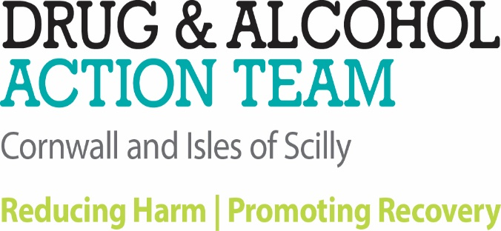
Basic Drug Awareness

Slide 2
Introductory Session
Housekeeping
Course Aims & outcomes
Way we will work
Breaks

Slide 3
Slides and follow up materials will be circulated afterwards … after you’ve submitted your evaluation form!
Notes:
Rich- perhaps have handouts of slides for them to make notes on?

Slide 4
Course Aims & Outcomes
Drugs and drug use in context –history
Attitudes to drugs and drug users
Commonly used drugs, their effects and relative harms.
Clarify some common terms associated with drug use and their meaning terms
Responses, resources and Interventions available
Notes:
Drugs and drug use in context – what we mean by a drug, psychoactive substances; drugs in history and the present day.
How attitudes to drugs and drug users impact
Increased understanding of commonly used drugs, their effects and relative harms.
Clarify drug terms such as what tolerance, withdrawal, addiction, harm reduction, dependency and recovery mean
Explore how people change and how this relates to responses and interventions

Slide 5
How we will work
On your own, interactive, quizzes, feedback, some discussion
Presentations with Q&A
There’s a lot of to cover!!!
Feedback and questions after the event are always welcome

Slide 6
Ground rules
Confidentiality
Take responsibility for your own learning
Don’t go away with questions unanswered – or contact us afterwards
No such thing as a stupid question
Strive to be aware of your own reactions

Slide 7
Your Learning goals
In pairs, 3 mins each (and will feedback to wider group after)
You and your role
Your level of confidence with the subject matter:
0 = I know nothing
10 = Ask me anything!
3. One sentence on what you’re hoping for from this training.
Notes:
Too much infor – we shape the session according to your priorities, so we don’t cover what you already know.

Slide 8
What is a drug?
Any substance that is taken for the effects that it produces on the brain and/or the body (whether man-made or naturally occurring) = psychoactive
In the pharmacological sense, caffeine, nicotine & alcohol are drugs, just as much as cocaine & heroin.
“Drug” has acquired a negative meaning or perception.
Notes:
WHAT IS A DRUG?3
However, for substances that act on the
mind (psychoactive), including stimulants,
sedatives, hallucinogens, deliriants or
dissociatives, the term drug has acquired a
negative meaning. In the pharmacological
sense, caffeine, nicotine and alcohol are
drugs just as cocaine and heroin are.
In popular usage, “drug” has taken on a
different meaning. Over the last century,
“drug” has come to mean a psychoactive
substance that is illegal. In this sense,
cannabis is a drug while alcohol is not (in most
countries); and substances such as morphine
are “medicines” when used by doctors,
and “drugs” when used recreationally.
Psychoactive substances are more accepted
by society when supplied as medicines.
Whether a substance is a drug in this usage
depends on the intention behind its use,
the mode of administration and the social
class of the user. And while in many cases
the active substances remain the same, the
perception is very distinct.

Slide 9
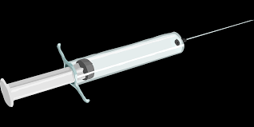
What is a drug?
Over the last century “drug” has come to mean a psychoactive substance when it is illegal.
Substances such as morphine are “medicines” when used by doctors,
and “drugs” when used recreationally.
Psychoactive substances are more accepted by society when supplied as medicines.
Notes:
Whether a substance is a drug in this usage
depends on the intention behind its use,
the mode of administration and the social
class of the user. And while in many cases
the active substances remain the same, the
perception is very distinct.

Slide 10
The function of a drug
Alterations in perception, mood, or consciousness.
Usually altering perceptions of the outside world via the five senses, or affecting the five senses.
May be used
recreationally,
to purposefully alter one's consciousness,
or for ritual, spiritual, or shamanic purposes,
or as a tool for studying or augmenting the mind.
Notes:
Drugs are often presented as unnatural contaminants, pushed into a society from the
outside or by deviant forces, and many people fear them. In reality, taking substances to
alter one’s mind seems to be a universal impulse, seen in almost all cultures around the
world and across history (though the substances used vary). Furthermore, while there
are certainly risks involved in all drug use, the legal status of a drug rarely corresponds
to the potential harms of that drug. In addition, the potential harms of a substance are
increased when it is produced, obtained and consumed illegally.

Slide 11
Drugs are often presented as unnatural contaminants, pushed into a society from the outside or by deviant forces, and many people fear them and those who take them.
‘Evil drugs’
In reality, taking substances to alter one’s mind seems to be a universal impulse, seen in almost all cultures around the world and across history (though the substances used vary).

Slide 12
While there are risks involved in all drug use, the legal status of a drug rarely corresponds to the potential harms of that drug.
But paradoxically, the potential harms of a substance are increased when it is produced, obtained and consumed illegally.
There is no quality control
with illegally produced drugs.

Slide 13
What is the earliest example of drugs or drug use that you can think of?

Slide 14
A Short History of Drugs
5000–4000 BC
-Descriptions of opium amongst the Sumerians (Mesopotamia)
  the use of varieties of hallucinogenic fungi in India.
Traces of opium found in Cyprus in a bronze-age vase shaped like an opium poppy.
400 BC ancient Greeks used opium widely (the time of Hippocrates) the ‘joy plant’
Notes:
Drugs have been used in all societies at least since records began.
The desire to achieve altered states of mind seems to be almost universal.
Different societies and cultures throughout history have experimented widely with different drugs

Slide 15
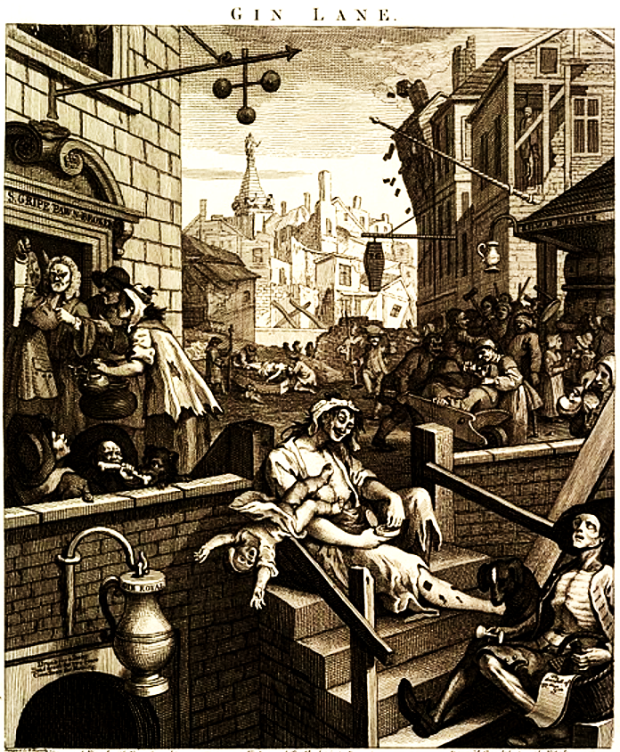
Constant evolution …
16th Century COFFEE is introduced and coffee houses are seen as dens of iniquity
16th Century TOBACCO ARRIVES IN BRITAIN
Sir Walter Raleigh brings tobacco from America, originally only used by the wealthy but then gradually spread wider.
1720- 1751 The Gin ‘Epidemic’
1736 The Gin Act
1798 SYRINGE INVENTED
Notes:
The earliest credible evidence of coffee-drinking appears in Yemen in southern Arabia in the middle of the 15th century in Sufi shrines.^{[5]} It was here in Arabia that coffee seeds were first roasted and brewed in a similar way to how it is now prepared. Coffee seeds were first exported from East Africa to Yemen, as the coffea arabica plant is thought to have been indigenous to the former.^{[6]} Yemeni traders took coffee back to their homeland and began to cultivate the seed. By the 16th century, it had reached Persia, Turkey, and North Africa. From there, it spread to Europe and the rest of the world.
Tobacco has long been used in the Americas, with some cultivation sites in Mexico dating back to 1400–1000 BC.^{[8]} Many Native American tribes have traditionally grown and used tobacco. Eastern North American tribes historically carried tobacco in pouches as a readily accepted trade item, as well as smoking it, both socially and ceremonially, such as to seal a peace treaty or trade agreement.^{[9][10]} In some populations, tobacco is seen as a gift from the Creator, with the ceremonial tobacco smoke carrying one's thoughts and prayers to the Creator.
Gin drinking in England rose significantly after the government allowed unlicensed gin production, and at the same time imposed a heavy duty on all imported spirits such as French brandy. This created a larger market for poor-quality barley that was unfit for brewing beer, and in 1695-1735 thousands of gin-shops sprang up throughout England, a period known as the Gin Craze.^{[10]} Because of the low price of gin, when compared with other drinks available at the same time, and in the same geographic location, gin began to be consumed regularly by the poor.^{[11]} Of the 15,000 drinking establishments in London, not including coffee shops and drinking chocolate shops, over half were gin shops. Beer maintained a healthy reputation as it was often safer to drink the brewed ale than unclean plain water^{[12]}. Gin, though, was blamed for various social problems, and it may have been a factor in the higher death rates which stabilized London's previously growing population.^{[8]} The reputation of the two drinks was illustrated by William Hogarth in his engravings Beer Street and Gin Lane (1751), described by the BBC as "arguably the most potent anti-drug poster ever conceived."^{[13]} The negative reputation of gin survives today in the English language, in terms like "gin mills" or the American phrase "gin joints" to describe disreputable bars, or "gin-soaked" to refer to drunks. The epithet "mother's ruin" is a common British name for gin, the origin of which is the subject of ongoing debate
The Gin Act 1736 imposed high taxes on retailers and led to riots in the streets. The prohibitive duty was gradually reduced and finally abolished in 1742. The Gin Act 1751 was more successful, however; it forced distillers to sell only to licensed retailers and brought gin shops under the jurisdiction of local magistrates.^{[8]} Gin in the 18th century was produced in pot stills, and was somewhat sweeter than the London gin known today.
In London in the early 18th century, much gin was distilled legally in residential houses (there were estimated to be 1,500 residential stills in 1726) and was often flavoured with turpentine to generate resinous woody notes in addition to the juniper.^{[15]} As late as 1913, Webster's Dictionary states without further comment, " 'common gin' is usually flavoured with turpentine".^{[9]}
Blue Ruin; The Cuckol’s delight
The routine use of drugs that would be thought of as seriously worrying today is famously reflected in literature of the 19th century. For instance, Dr Watson asked Sherlock Holmes, seeing him injecting, “Which is it today, morphine or cocaine?” Holmes testified to the power of cocaine to stimulate and clarify his mind.

Slide 16
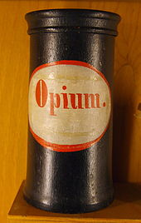
Marketing, Packaging and
Branding

Slide 17
Empire built on opium
1800s East India Company starts trafficking opium from India to China.
1839-1860 The Opium Wars
NAPOLEONIC SOLDIERS GET STONED
Napoleon’s army brings cannabis back from Egypt.
“It is forbidden in all of Egypt to use certain Moslem beverages made with hashish or likewise to inhale the smoke from seeds of hashish. Habitual drinkers and smokers of this plant lose their reason and are victims of violent delirium which is the lot of those who give themselves full to excesses of all sorts.”
Use continued, even among scientists in his army, who brought it back for research purposes, caused popular fascination and use, and it began to blamed for “brutal actions … frenzy and violence.”
1820s Morphine – Morphomania. Women.
Notes:
The First Opium War, during 1839–1842, was concluded by the Treaty of Nanking in 1842. The treaty ceded the Hong Kong island to the United Kingdom in perpetuity, and it established five treaty ports at Shanghai, Canton, Ningpo, Fuchow, and Amoy. Another treaty the next year gave most favored nation status to the United Kingdom and added provisions for British extraterritoriality. Then France secured concessions on the same terms as the British, in treaties of 1843 and 1844.
During 1856–1860, British forces fought towards legalisation of the opium trade, to expand coolie trade, to open all of China to British merchants, and to exempt foreign imports from internal transit duties. France joined the British. The war is also known as the "Arrow War", referring to the name of a vessel at the starting point of the conflict. The war resulted in a second group of treaty ports being set up; eventually more than 80 treaty ports were established in China, involving many foreign powers. All foreign traders gained rights to travel within China
Napoleon
Although it had not been his intention of doing so, Napoleon's military exploits were also responsible for introducing thousands of French soldiers to hashish. The initiation came about as a consequence of the French invasion of Egypt in 1798 and caused Napoleon some concern that his troops might become dissipated and unruly because of their indulgence in the drug.
Then, as now, army life was basically a series of endless routines and insurmountable boredom. To pass the time, some men will drink themselves into oblivion. But in Moslem Egypt, alcohol was not the intoxicant of choice. The Egyptians preferred another drug, and that drug, of course, was hashish. So widespread did the hashish habit become among his men that in October 1800 Napoleon issued the following ordinance to the French army of occupation:
It is forbidden in all of Egypt to use certain Moslem beverages made with hashish or likewise to inhale the smoke from seeds of hashish. Habitual drinkers and smokers of this plant lose their reason and are victims of violent delirium which is the lot of those who give themselves full to excesses of all sorts. [2]
The soldiers heard the order, probably nodded in agreement, and went right on using hashish. Along with the soldiers, three French scientists - Silvestre de Sacy, Rouyer, and Desgenettes - whom Napoleon had brought with him to study the country and its people, also began using hashish, ostensibly to see for themselves what this drug did to the human body. Intrigued by their experiences with hashish, they sent some back to France for their colleagues to conduct further experiments in their laboratories.
The first of these studies to be published appeared in 1803 by a Dr. Virey, who made various extracts of hashish, hoping to track down the drug's elusive active principle. After studying the drug at length, it was Virey's opinion that hashish was nothing less than the mysterious nepenthe used by Helen of Troy to drug her guests into a stupor of forgetfulness.
Soon after the army's return, the French began hearing about the incredible effects of hashish from both the soldiers who had used it themselves and from the country's scientists who had had an opportunity to study the drug and its mystique while serving with the army in Egypt. It was shortly after the army's return to France, for instance, that Silvestre de Sacy, the foremost Arabic scholar in the world at that time, announced that he had at last solved the long-baffling mystery of the origin of the name of the Assassins - the Arabic gang of cutthroats who had terrorized the Middle East at the time of the Crusades. In an address to the Institute of France in 1809, Silvestre de Sacy claimed that the word "assassin" was derived from hashish, a common term for herbage or grass in the Arab world. He then argued that cannabis was considered to be like grass and that the mysterious potion mentioned by Marco Polo was in fact hashish:
The intoxication produced by the hashish [can lead to a] state of temporary insanity [such that] losing all knowledge of their debility [users] commit the most brutal actions, so as to disturb the public peace... it is not impossible that hemp, or some parts of that vegetable, mixed with other substances unknown to us, may have been sometimes employed to produce a state of frenzy and violence. [3]

Slide 18
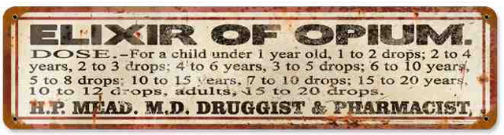
1860 Cocaine was first isolated by the German chemist Albert Niemann in 1860, and rapidly gained popularity for both recreational and medical use, as a local anaesthetic and in nasal surgery.
THINGS GO BETTER WITH COKE? Coca-Cola (originally containing cocaine) introduced in the UK.
1868 – Pharmacy Act. First regulation of poisons & dangerous substances. Limited sales to chemists.

Slide 19
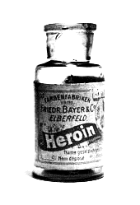
1874 Heroin first synthesized – the strongest painkiller
1898 Heroin becomes available as an over-the-counter drug -along with aspirin - in UK pharmacies

Slide 20
National and International Regulation
1908 – Poisons and Pharmacy Act.
Regulations on sale and labelling, including coca.
1912 the Hague Treaty discussed controlling opium traffic (also included cannabis)
1916 Defence of the Realm Act: Cocaine & the troops.
1916 Heroin banned, permanently in 1920.
1920 Dangerous Drugs Act introduces punishment and compliance with international regulations.
1925 – Dangerous Drugs Act.
Controlled importation of coca leaf and cannabis.
Notes:
Heroin first banned in 1916, permanently from 1920.

Slide 21
1926 HEROIN ON THE STATE The Rolleston committee decided that there were circumstances in which heroin addicts should be given the drug on prescription. The ‘British System’ (cf. HAT: Heroin Assisted Treatment)
1926 METHADONE PATENTED Although it was not used to treat drug dependency until the 1960’s.
1928 – Amendment to Dangerous Drugs Act criminalising possession of cannabis. Doctors continued to be able to prescribe any drugs as treatments, including for addiction
1938 LSD First produced to treat high blood pressure
Now being researched as a Mental Health medication
Notes:
Albert Hofmann, a Swiss chemist, gave himself the first ever dose of LSD while working on compounds intended to control blood pressure. First produced in 1938.

Slide 22
1943 MOTHERS’ LITTLE HELPERS Valium and Librium, the first benzodiazepines. Originally described as safe and non-addictive!
1958 The 1st Brain Committee: Low levels of addiction (UK)
1961 The UN Convention on Narcotic Drugs
1964 The 2nd Brain Committee: Increased levels of addiction to Cocaine & Heroin via medical prescribing by a few Doctors in just 6 years.
1964 The Drugs (Prevention of Misuse) Act: Amphetamines

Slide 23
1924 – 1926: The Rolleston Committee had defined addiction, mainly seen among 500 middle class women
1964 The 2nd Brain Committee reacted to the new trend of misfit drug users, and recommended the establishment of special treatment centres these became known as Drug Dependency Units, or DDUs.
1964 – Dangerous Drugs Act, following UN 1961 Single Convention. Criminalised cultivation of Cannabis.
1964 - Drugs (Prevention of Misuse Act)
Criminalised possession of Amphetamines.
Notes:
1958 The 1st Brain Committee stated that the incidence of addiction to dangerous drugs in Great Britain was small
1961 The UN Convention on Narcotic Drugs
1964 The 2nd Brain Committee -showed that there had been a significant rise in the incidence of addiction to heroin and cocaine, that the main source of supply was a small number of over-prescribing doctors.
1964 The Drugs (Prevention of Misuse) Act -The importation of lysergamide and its derivatives was restricted by this Act.
This Act added synthetic amphetamine type drugs to restriction
The Rolleston Committee defined addiction and recommended the establishment of special treatment centres these became known as Drug Dependency Units, or DDUs.

Slide 24

So, is this a Health or a Criminal Justice issue … ???
1968 The Medicines Act
1968 RISING HEROIN USE
1971 The Misuse of Drugs Act - ACMD established; (UN Convention on Psychotropic Substances)
1982 ACMD Treatment report
1986 Drug Trafficking Offences Act
Notes:
The Act defines three categories of medicine: prescription only medicines (POM),^{[2]} which are available only from a pharmacist if prescribed by an appropriate practitioner; pharmacy medicines (P), available only from a pharmacist but without a prescription; and general sales list (GSL) medicines which may be bought from any shop without a prescription.
The Act controls supply of the drugs it covers, but does define any offence of simple possession. Possession of a prescription only drug without a prescription is only an offence if the drug is also controlled under the Misuse of Drugs Act 1971 and possession is thus specified as an offence. Therefore, for example, possession of a prescription only antibiotic without a prescription is not an offence.

Slide 25
1980’s Harm Reduction
1980’s FIRST UK NEEDLE EXCHANGE ESTABLISHED
Ecstasy use becomes widespread on the dance scene and becomes a Class A drug.
1988 ACMD AIDS and Drugs report ‘ The threat of AIDS a greater threat to public health than Drugs Misuse’
1995 ‘Tackling Drugs Together ‘
First joint ministerial strategy
1990’s DRUG PRODUCERS WORK AROUND LEGISLATION ‘Legal highs’ and ‘club drugs’

Slide 26
1990’s Drugs & Crime
A mess of reactive legislation
1991 – Criminal Justice Act 1991 a probation order could have attached a condition of attending drug treatment.
1998 – Crime and Disorder Act. Created the Drug Treatment and Testing Order (DTTO).
2000 – Criminal Justice and Court Services Act. People charged with certain offences could be tested for drugs by police. Introduced testing for prisoners released subject to supervision.

Slide 27
2003 - Anti-Social Behaviour Act. Premises used for Class A drugs supply could be closed.
2005 – Drugs Act. Introduced drug testing on arrest. Classified psilocybin mushrooms as drugs. Required treatment assessment could not be refused. Penalties for dealing near schools increased.
2006 – Police and Justice Act. Punitive conditions can be attached to conditional cautioning.
2007 – Drugs Act 2005 (Commencement No. 5) Order 2007 (S.I. 2007/562)
2008 – Controlled Drugs (Drug Precursors) (Intra-Community Trade) Regulations 2008 (S.I. 2008/295)
Controlled Drugs (Drug Precursors) (Community External Trade) Regulations 2008 (S.I. 2008/296)
2008 – The Misuse of Drugs Act 1971 (Amendment) Order 2008 (S.I. 2008/3130)
2009 –The Misuse of Drugs (Designation) (Amendment) (England, Wales and Scotland) Order (SI 2009/3135)
2009 –The Misuse of Drugs (Amendment) (England, Wales and Scotland) Regulations (SI 2009/3136)
2009 –The Misuse of Drugs Act 1971 (Amendment) Order (SI 2009/3209)
2016 - Psychoactive Substances Act 2016

Slide 28
Great drug users in history
Francis Crick
John C. Lilly
Kary Mullis
Sigmund Freud
Winston Churchill
Steve Jobs
Paul Erdos
Robert Louis Stevenson
Samuel Taylor Coleridge
Charles Dickens
Richard Feynman
Arthur Conan-Doyle
Notes:
The legendary molecular biologist Francis Crick was a great advocate of LSD.
Neurocientist John Cunningham Lilly was the most important figure in the field of electronic brain stimulation. He extensively experimented with LSD and ketamine.
John C. Lilly — LSD, Ketamine
Kary Mullis — LSD
Kary Banks Mullis was an American biochemist who won the 1993 Nobel Prize in Chemistry for making valuable improvements to polymerase chain reaction (PCR) technique. Mullies once told California Monthly that he “took plenty of LSD”
Paul Erdös was a leading Hungarian mathematician and a highly prolific author. Known for his eccentric personality, reportedly wasn’t able to get any mathematical work done for almost a month when he quit taking amphetamine as he’d made a $500 bet with his friend Ronald Graham.
Richard Feynman — LSD, Marijuana, Ketamine
Steve Jobs, arguably the most revered pioneer in the personal computer revolution, once stated that experimenting with LSD in the 1960s was “one of the two or three most important things he had done in his life.”

Slide 29
Great drug users in history
Francis Crick: Molecular Biologist, DNA, used LSD
John C. Lilly: Neuroscientist - LSD and Ketamine
Kary Mullis: DNA and the polymerase chain reaction (PCR) - LSD
Sigmund Freud: Psychoanalysis - Cocaine
Winston Churchill: War time leader - Amphetamines
Steve Jobs: Apple - LSD
Paul Erdos: Mathematician / Author - Amphetamine
Robert Louis Stevenson: Author - Cocaine
Samuel Taylor Coleridge: Poet / Philosopher - Opium
Charles Dickens: Author - Opium
Richard Feynman: Quantum Physicist - LSD, Marijuana, Ketamine
Arthur Conan-Doyle: Creator of Sherlock, who used Cocaine, Opium, etc
Notes:
The legendary molecular biologist Francis Crick was a great advocate of LSD.
Neurocientist John Cunningham Lilly was the most important figure in the field of electronic brain stimulation. He extensively experimented with LSD and ketamine.
John C. Lilly — LSD, Ketamine
Kary Mullis — LSD
Kary Banks Mullis was an American biochemist who won the 1993 Nobel Prize in Chemistry for making valuable improvements to polymerase chain reaction (PCR) technique. Mullies once told California Monthly that he “took plenty of LSD”
Paul Erdös was a leading Hungarian mathematician and a highly prolific author. Known for his eccentric personality, reportedly wasn’t able to get any mathematical work done for almost a month when he quit taking amphetamine as he’d made a $500 bet with his friend Ronald Graham.
Richard Feynman — LSD, Marijuana, Ketamine
Steve Jobs, arguably the most revered pioneer in the personal computer revolution, once stated that experimenting with LSD in the 1960s was “one of the two or three most important things he had done in his life.”

Slide 30
Attitudes
Exercise
Pick a substance you have chosen or decided not to use

Slide 31
Attitudes
2. What information led you to make that decision?
    Parent?
    School?
    Media?
    Personal experience?
How did you judge the credibility of the source?

Slide 32
Attitudes to Drugs & Drugs Users
That attitudes to drug use are so strongly held and often so tenuously tied to facts should be a matter of no small concern.
How drugs are seen has an important bearing on how drug takers are perceived.
Negative and ill-informed beliefs about drugs can be expected to translate themselves into negative and ill-judged reactions to drug users.
Griffiths and Pearson, 1988
Notes:
The War on

Slide 33
Attitudes to Drugs and Drug Users
RELIGIOUS MORAL Weak Evil Depraved Sinner NEED SAVING | MEDICAL Sick Disease Mentally deficient Crazy NEED TREATMENT
LEGAL Criminals Bad NEED PUNISHMENT | SOCIAL Normal Victim Lack of resilience NEED HELP
Drug
User
Notes:
PERCEPTIONS SURROUNDING PEOPLE WHO USE DRUGS
When considering the reasons why someone might take drugs, psychological and moral explanations generally prevail, primarily the assumption that the person is “weak” or “immoral.” Thus, the general public often sees problematic drug use as an individual problem and not one that society needs to deal with. Another common stereotype of people who use drugs is that of people living on the margins of society, who are not equal members of it or entitled to the same rights as others.
These perceptions and stereotypes contrast with what experts consider to be the primary reasons for consuming drugs. These include youthful experimentation, pursuit of pleasure, socializing, enhancing performance, and self-medication to manage moods and physical pain.
Another widespread perception is that people who use drugs, and particularly people with problematic drug use, engage in criminal activities. But the vast majority of those who use drugs are not committing any crime other than the contravention of drug laws.
Individuals with problematic drug use often cannot afford the drugs they need without resorting to crime themselves. In addition, people who use drugs are often forced out of the mainstream and into marginalized subcultures where crime is rife. Once they have a criminal record, they find it much harder to find employment, thus making the illegal
market and criminal activity among their only means of survival.
PORTRAYALS IN THE MEDIA AND AMONG THE GENERAL PUBLIC
The perceptions discussed in the report are largely influenced by the media, which portray the effects of drugs as overwhelmingly negative. Two narratives of drugs and people who use them have been dominant: one links drugs and crime, the other suggests that the devastating consequences of drug use on an individual are inevitable.
Public opinion and media portrayals reinforce one another, and they contribute to and perpetuate the stigma associated with drugs and drug use. Commonly encountered terms such as “junkie,” “drug abuser”, and “crackhead” are alienating, and designate people who use drugs as “others” – morally flawed and inferior individuals.
Such stigma and discrimination, combined with the criminalization of drug use, are directly related to the violation of the human rights of people who use drugs in many countries. Therefore, in order to change how drug consumption is considered and how people who use drugs are treated, we need to shift our perceptions, and the first step is
to change how we speak.
THE LINK BETWEEN PERCEPTIONS OF DRUGS, THOSE WHO USE THEM,AND DRUG CONTROL POLICIES
The link between the perception of drugs, the people who use them, and drug policy
constitutes a vicious cycle. Under a prohibitionist regime, a person who uses drugs is
engaging in an act that is illegal, which increases stigma. This makes it even easier to
discriminate against people who use drugs, and enables policies that treat people who
use drugs as sub-humans, non-citizens, and scapegoats for wider societal problems.
First, the fear of drugs has translated into messages for prevention that promote complete
abstinence and state that all drugs are equally bad. However, providing information
which is incomplete and often even incorrect lessens any chance of trust between the
authorities and young people. A better way forward would be to offer honest information,
9
encourage moderation in youthful experimentation, and provide knowledge on safer practices.
Second, drug use is perceived as a moral issue, considered a public wrong, and is therefore criminalized, even though drug consumption itself is a non-violent act, and poses potential physical harm only to the person who engages in it. Yet in many countries the death penalty is applied to some non-violent drug offenses, placing them de facto on a similar moral ground to murder and other most serious crimes.
A change of perceptions and policies is already underway in some countries. Leadership and information have played a critical role in showing that the public can support more pragmatic and evidence-based drug policies when it has been given credible information. It has been possible to persuade people concerned about public order and security that alternative drug policies can be more effective at reducing drug-related harms for users, their immediate environment, and society as a whole.

Slide 34
Attitudes affect behaviour
Behaviour contributes to stigmatisation

Slide 35
Stigma
Derived from a Greek word for a mark or stain
Refers to beliefs and/or attitudes.
Can be described as a dynamic process of devaluation that significantly discredits an individual in the eyes of others
Stigma can be diminished when people believe that an individual is not responsible (“It is not their fault”) or their behaviour is beyond their control (“They cannot help it”).

Slide 36


Slide 37
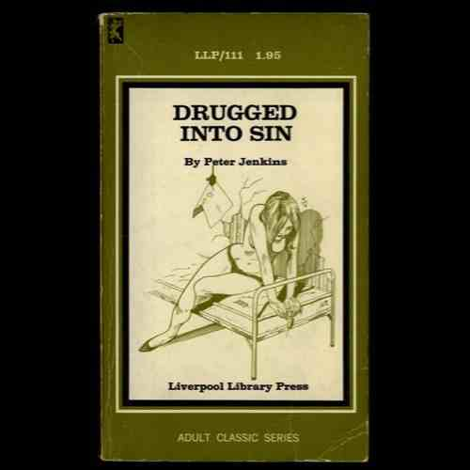

Slide 38
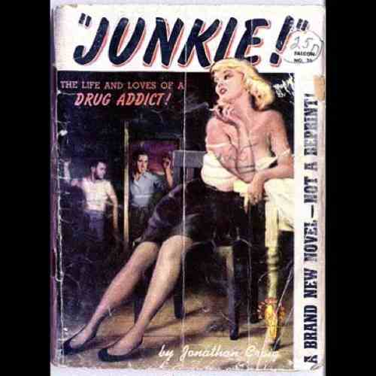

Slide 39
Stigma
When stigma is acted upon, the result is discrimination.
Discrimination refers to any form of arbitrary distinction, because of an inherent personal characteristic or perceived membership of a particular group.
It is a human rights violation.
Stigmatisation kills

Slide 40
Drug Classifications, Schedules and Types:
Classes are intended to define the legal consequences based on potential harms

Slide 41
Drug Classifications, Schedules and Types:
Classes are intended to define the legal consequences based on potential harms
The 5 Schedules define the level of control needed, covering import, export, production, supply, possession, prescribing, and record keeping which apply to them.
Click here for full current UK Government substance listings

Slide 42
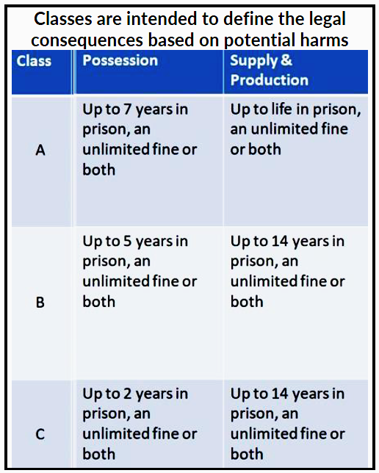
Drug Classifications, Schedules and Types:

Slide 43
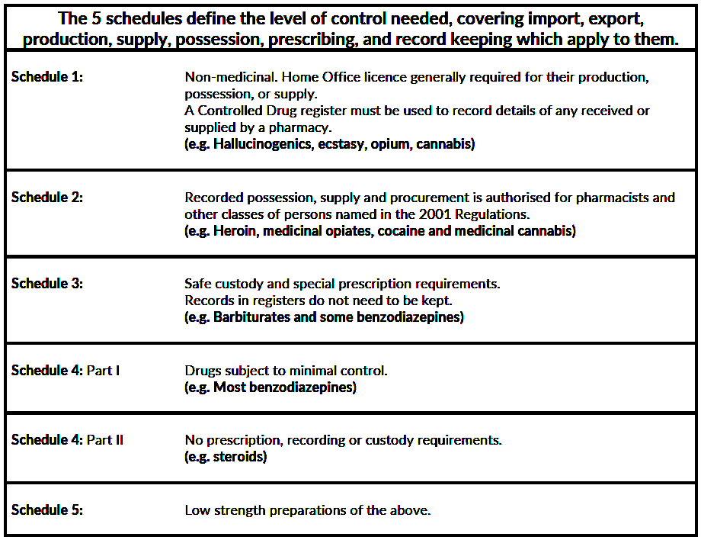

Slide 44
Drug Types & Their Effects
Stimulants – stimulate the central nervous system ‘uppers’
e.g. cocaine, amphetamines, caffeine
Notes:
VSA

Slide 45
Drug Types & Their Effects
Stimulants – stimulate the central nervous system ‘uppers’
e.g. cocaine, amphetamines, caffeine
Depressants – depress the central nervous system ‘downers’
e.g. tranquilisers, alcohol, heroin (analgesics)
Notes:
VSA

Slide 46
Drug Types & Their Effects
Stimulants – stimulate the central nervous system ‘uppers’
e.g. cocaine, amphetamines, caffeine
Depressants – depress the central nervous system ‘downers’
e.g. tranquilisers, alcohol, heroin (analgesics)
Psychedelics -Perceptual alteration / Halucinogens
e.g. LSD, psychedelic mushrooms
Notes:
VSA

Slide 47
Drug Types & Their Effects
Stimulants – stimulate the central nervous system ‘uppers’
e.g. cocaine, amphetamines, caffeine
Depressants – depress the central nervous system ‘downers’
e.g. tranquilisers, alcohol, heroin (analgesics)
Psychedelics -Perceptual alteration / Halucinogens
e.g. LSD, psychedelic mushrooms
Cannabinoids
Volatile substances
e.g. glue and solvents
Others
Treatment to help
people to address
different drugs within
each type will be similar
Notes:
VSA

Slide 48
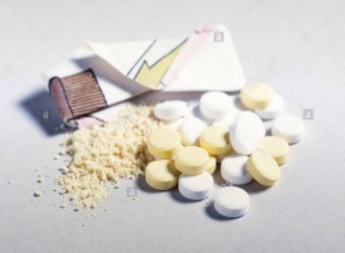
Amphetamines
Method of use:
Sulphate: snorted, rubbed on gums, IV, swallowed
Ice/Base: smoked, swallowed, IV
AKA: Amphetamine: speed, whizz, billy, sulph, base
Methamphetamine: ice, glass, shard, meth, tina, crank
Law:
Amphetamine: Class B, schedule 2
Methamphetamine: Class A, schedule 2
Cost: £10 per gram / £100 per ounce
Popularity: 4.6% of 16-24 year olds April 2019 to March 2020
Duration:
Speed 2-3hr
Ice 12-24hr
Source:
Manufactured in UK and Europe
Effects:
+ve: alert, energetic, awake, confident, less appetite, talkative
-ve: anxiety, paranoia, nausea
Risks: weight loss, insomnia, tooth damage, nasal damage, mental health problems, health failure, convulsions
Indicators: dilated pupils, restless, talkative, anxious, grinding teeth

Slide 49
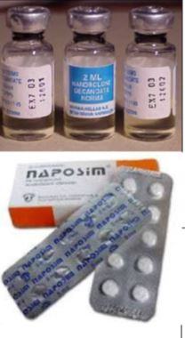
Anabolic Steroids
Method of use: swallowed, muscular injections
AKA: AAS, juice, roids, Testosterone, Sust, Deca, Winny and many more
Law: Class C, schedule 4. Legal to possess without prescription but illegal to supply
Popularity: 0.5% of 16-24 year olds April 2019 to March 2020
Cost: £10-£30 per vial, pills are cheaper
Duration: ½ - 7 days+ depending on type
Effects:
+ve: energy, muscular development, assertive, gain bulk
-ve: insomnia, irritability, health risks
Source: Manufactured – sold via internet and gyms
Indicators: muscular growth, bloat, acne
Risks:
Men: impotence, testicular shrinkage, prostate cancer, high blood pressure, acne, baldness, breast growth
Women: deeper voice, face and chest hair, fertility problems

Slide 50
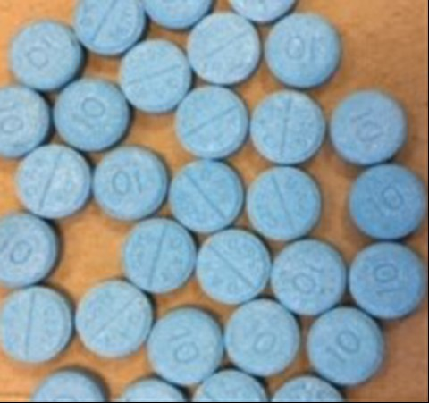
Benzodiazepines
AKA: Benzoes, tranx, downers, sleepers. Valium: blues, vallies Alprazolam: Xanax, Xs Temazepam: eggs, Temazies Flunitrazepam: Rohypnol, rufies
Many other names
Method of use: swallowed, injecting (rarely)
Law: Class C, schedule 3
Cost:
Diazepam: 50p-£1 per tab, £110-£120 for 1000 tabs
Alprazolam & Etizolam: £1-£3 per tab
Popularity: 2.4% of 16-24 year olds April 2019 to March 2020
Duration: 2-200hrs+ depending on type
Source: prescribed, internet, street
Effects:
+ve: relaxation, calm, drowsiness, mild euphoria, relaxed muscles
-ve: anxiety, disinhibition, anger, amnesia
Risks: dependency, overdose, reckless behaviour, Fake drugs – especially online, dangerous withdrawals
Indicators: drowsy, slow reactions, calm

Slide 51
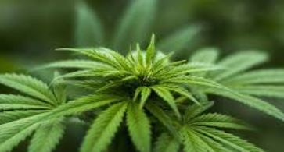
Cannabis
Method of use: smoked in ‘spliffs’ with tobacco, vaping, in pipes, bongs, also eaten and drunk
AKA: herb, resin, weed, skunk, puff, dope, Ganj, marijuana, hemp, black, hash, sensi
Law: Class B, schedule 1
Cost:
Skunk/bud £10 per gram
Leaf/hash/resin £10 for 1/8th, £5 for 1/16th
Oil £30-£60 per gram, £160-£200 per ounce
Popularity: 32.6% of 16-24 year olds April 2019 to March 2020
Duration: smoked 1-2hr, eaten 3-6hr
Source: homegrown, imported from Europe, Africa, Asia
Effects:
+ve: relaxation, calm, hilarity, altered perception, munchies, drowsiness
-ve: panic attacks, nausea
Risks: apathy, lethargy, short term memory loss, increased risk of mental health problems, lung problems, dependency
Indicators: red eyes, husky voice, smell of burning, dismantled cigarettes, torn card, munchies

Slide 52
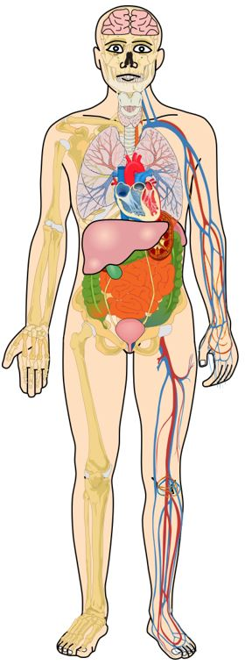
Cannabis
Harm and Reduction
Risk of mental health problems, psychosis
Reduce intake
Adhere to meds, if required
Avoid stronger strains of cannabis
Know warning signs
Stop using if negative symptoms appear
Risk of accidents, falls, trauma
Avoid risky drinking environments
Extinguish naked flames at night
Don’t drive
Lung problems
Don’t smoke
Avoid use of tobacco
Use water pipes or similar
General
Don’t smoke every day
Reduce strength/amount smoked
Maintain other hobbies and interests
Be aware of contaminants in poor quality resin
Weight gain
Use ‘healthy’ munchies
Legal risks
Possession is still illegal
Supply and cultivation can carry heavy penalties

Slide 53
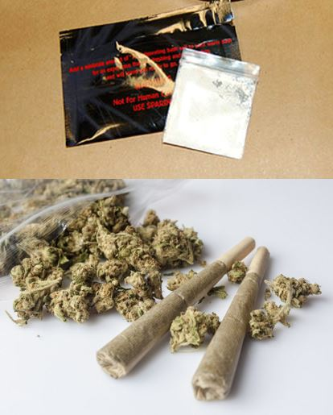
Synthetic Cannabinoids
Method of use: smoked, in pipes or with tobacco, some reports of swallowing or snorting
AKA: synth canna, pot pourri, incense, SCRAs, smoking mix, spice, mamba
Brand names: pre-PSA brands included Psyclone, Exodus Damnation, Pandora’s Box
Law: Class B, schedule 1
Cost: £5 per gram
Popularity: 4% of 16-24 year olds April 2019 to March 2020
Source: street supply as residual stock from web/shops sold off
Duration: 30-60 mins – may be much longer with unpleasant comedown
Effects:
+ve: euphoria, relaxation, sensory change, stoned feeling
-ve: nausea, panic, paranoia, muscle spasms, disorientation, hallucinations
Indicators: empty packages, appearing very ‘stoned’, possible anxiety, no cannabis smell, possible solvent smell
Risks: breathing problems, panic, anxiety, convulsions, paralysis, very fast HR, altered perception, acute mental health problems, persisting psychosis, vomiting, habit forming, lots of redosing, tolerance, risk of heart failure, kidney problems. Some fatalities

Slide 54
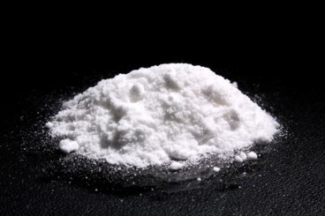
Cocaine and Crack
Method of use:
Cocaine powder: snorted, rubbed on gums, IV
Crack: smoked, swallowed, IV
AKA:
Cocaine: Charlie, coke, snow
Crack: rock, freebase, white, stones, bones
Law: Class A, schedule 2
Cost:
Coke: £40 per gram (standard), £80-£100 per gram (better quality)
Crack rocks: (0.1g) £10 each
Popularity:
Cocaine: 10%*
Crack: 0.5%*
*of 16-24 year olds April 2019 to March 2020
Duration:
Sniffed: 1-2hr
Smoked: 15mins
Source: processed from Coca plant in South America. Crack made in UK from Cocaine
Effects:
+ve: alert, energetic, awake, euphoric, confident, less appetite, talkative
-ve: anxiety, paranoia, delusional
Risks: weight loss, insomnia, tooth damage, nasal damage, mental health problems, addiction, lung damage (if smoking crack), convulsions, heart failure, high blood pressure, death
Indicators: dilated pupils, restless, talkative, anxious, grinding teeth

Slide 55
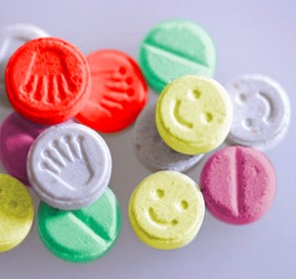
MDMA (Ecstasy)
Method of use: swallowed, MDMA powder - snorted
AKA: E, eccies, tabs, pills, XTC, molly, doves, apples, mitsubishies etc
Law: Class A, schedule 1
Popularity: 10.1% of 16-24 year olds April 2019 to March 2020
Cost: £5-£10 per tab, crystal £40 per gram
Duration: 30-60mins onset, 3-5hrs duration
Source: made in Europe and Asia
Effects:
+ve: energetic, mild hallucinations, positive mood, sleepless, low appetite, feelings of empathy & closeness, libido
-ve: anxiety, panic attacks, nausea, hot, flushed, dizzy
Indicators: dilated pupils, grinding teeth, sweaty, happy mood, energetic, clenched jaw
Risks: death from heat stroke, liver/kidney failure, heart failure, reaction to pill, excess water intake, convulsions/fits, low mood in comedown, depression

Slide 56
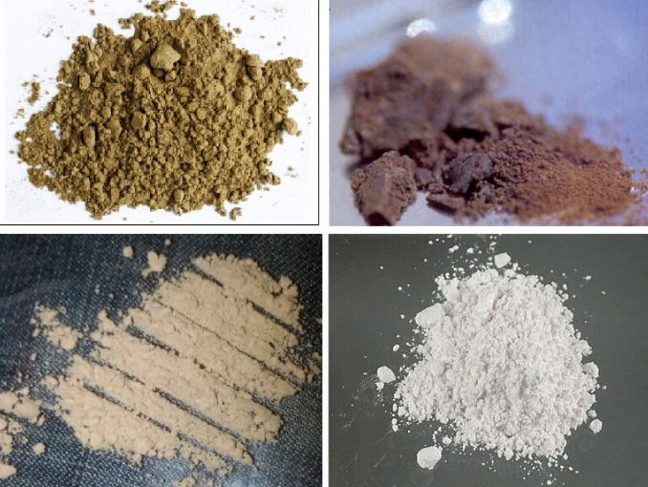
Heroin
Method of use: smoked – chasing the dragon/booting, injected, rectal
AKA: Diamorphine, brown, skag, smack, gear, H, china white
Law: Class A, schedule 2
Cost: £10 per bag (0.1g)
Popularity: 0.1% of 16-24 year olds April 2019 to March 2020
Source: processed from poppies (mainly in Afghanistan)
Duration: 6 hrs
Effects:
+ve: calm, relaxed, euphoric, drowsy, pain relief
-ve: suppressed cough, itchy skin, constipation
Indicators: constricted pupils, drowsy, itching, ‘nodding off’, slow pulse, shallow breathing
Risks: addiction, overdose, injecting complications, death

Slide 57
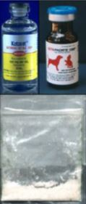
Ketamine
Method of use: snorted, injected, swallowed
AKA: K, super K, vitamin K
Law: Class B, schedule 3
Popularity: 5.6% of 16-24 year olds April 2019 to March 2020
Cost: £30-£40 per gram
Duration: 2-3hrs
Source: imported from Asia, European manufacture, vets
Effects:
+ve: hallucinatory, altered thinking, mild euphoria, calm detachment
-ve: nausea, paralysis, scary hallucinations, loss of muscular control
Risks: nausea, mental health problems, hurting self while intoxicated, dependency, acute bladder problems, loss of consciousness
Indicators: partially paralysed, not speaking or moving much, dilated pupils

Slide 58
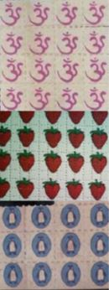
LSD
AKA: Lysergic Acid Diethylamide, acid, tabs, trips, strawberries, ohms, barts, etc
Method of use: swallowed, held in mouth
Law: Class A, schedule 1
Cost: £5 for small microdot
Popularity: 3.6% of 16-24 year olds April 2019 to March 2020
Source: made in Europe, UK
Duration: 8-12hrs
Indicators: dilated pupils, delusional behaviour, altered thinking
Effects:
+ve: hallucinatory, altered thinking
-ve: panic, scary visions or thoughts
Risks: mental health problems, accidents when intoxicated

Slide 59
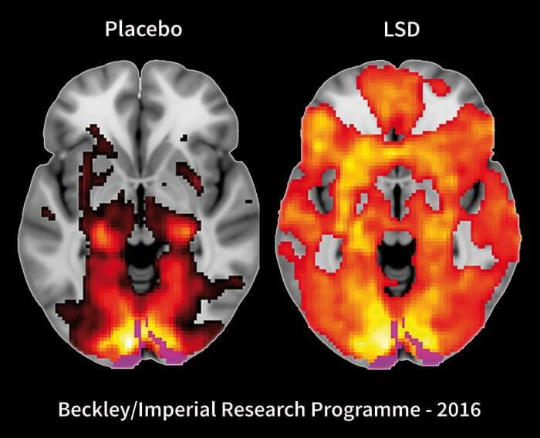

Slide 60
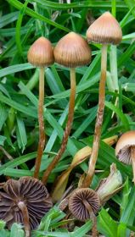
Magic Mushrooms -Psilocybin
AKA: shrooms, mushies, cubies, liberty caps
Method of use: swallowed – raw, cooked in food, brewed in drink
Law: Class A, schedule 1
Cost: free if picked yourself
Popularity: 4.5% of 16-24 year olds April 2019 to March 2020
Source: grow in the UK
Duration: 4-6hrs
Effects:
+ve: hallucinatory, altered thinking
-ve: panic, scary visions or thoughts, nausea
Indicators: dilated pupils, delusional behaviour, altered thinking
Risks: mental health problems, accidents when intoxicated, picking wrong mushrooms, infections from unclean mushrooms

Slide 61
Risks and Relative Harm
In 2 teams, put the drugs in a list of relative harms from highest to lowest.
10 mins
Notes:
1 Alcohol
2 Heroin
3 Crack Cocaine
4 Meth
5 Cocaine
6 Tobacco
8 Cannabis
17 Ecstasy
18 LSD

Slide 62
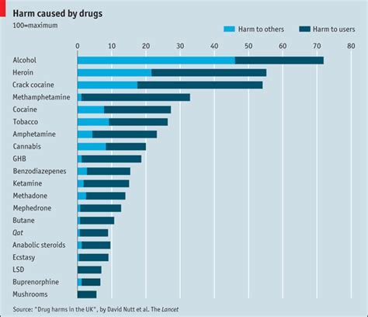

Slide 63
Drugs & the Law
The Misuse of Drugs Act (1971)
Intended to prevent non medical use of drugs
Drugs subject to the Act = ‘controlled drugs’
Offences
Unlawful supply
Intent to supply
Import or export (‘trafficking’)
Unlawful production
Unlawful possession – powers to stop, search and detain on ‘reasonable suspicion’

Slide 64
Class A
Cocaine (and ‘crack’)
Heroin*
Ecstasy
LSD
Methadone*
Methamphetamine (crystal meth)
Magic Mushrooms
Any Class B which is injected
If prescribed by a doctor, not illegal

Slide 65
Class B
Amphetamines
Barbiturates
Codeine
Ketamine
Cannabis
Cathinones (mephedrone) 2010
GHB and GBL
Nitrous Oxide

Slide 66
Class C
Anabolic Steroids
Minor tranquilisers
Khat

Slide 67
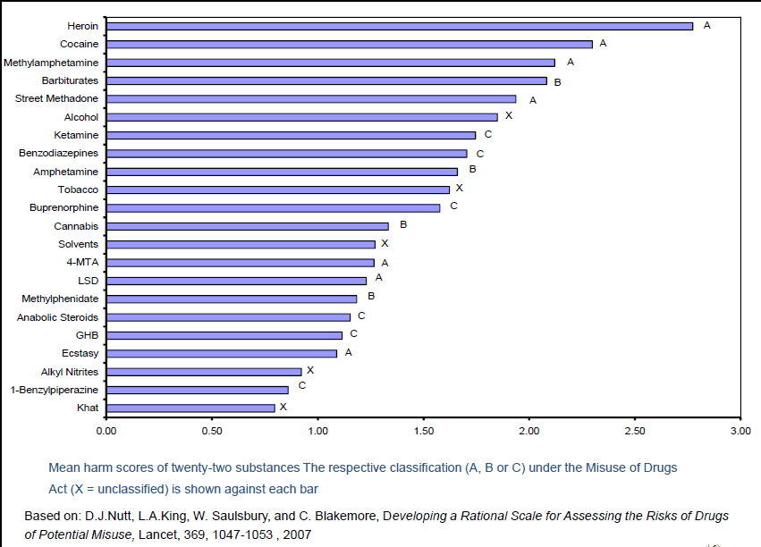
Notes:
Drugs are not ‘evil’

Slide 68
Novel Psychoactive Substances
Substance that produce the same or similar effects to drugs such as ecstasy or cocaine
Structurally different enough
Were not controlled under MDA but now covered by Psychoactive Substances Act
Large number of different types and forever growing (Class D)

Slide 69
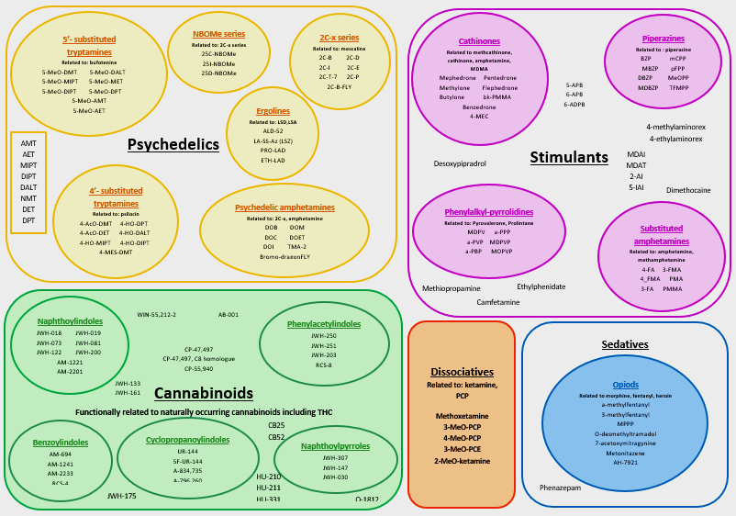
Notes:
New psychoactive substances proliferating rapidly

Slide 70
Psychoactive Substances Act (2016)
Makes it an offence to produce, supply or offer to supply any psychoactive substance if it is likely to be used for its psychoactive effects and regardless of its potential for harm.
          Only exemptions:
          MDA drugs
          Nicotine
          Alcohol
          Caffeine
          Medicinal products
          Poppers
          Nitrous Oxide
          Food and drink

Slide 71
Types of Drug Use
EXPERIMENTAL
RECREATIONAL
DEPENDENT
Notes:
What questions can you ask to ascertain what type of drug use it is?

Slide 72
Types of drug use
Experimental – have you tried this before? Where? With whom?
Recreational – how often? In what circumstances?
Dependent- Daily? what happens when you stop?
Self harm/poisoning – what were you seeking?
Notes:
Different types have different risks and therefore different responses are required.

Slide 73

Types of Risks
PERSON SPECIFIC
ROUTE SPECIFIC
SITUATION SPECIFIC
SUBSTANCE SPECIFIC RISKS RELATING TO LEGALITY

Slide 74
Types of Risks
Substance specific (Most important point of whole course!)
- Depressants potentiate each other:
Alcohol + valium = multiply
Alcohol + heroin = multiply
Alcohol + valium + heroin= !!!
Stimulants (e.g. heart, dehydration,)
Ketamine
Illegality = no quality control. What is it cut with?
Poisoning
Fluctuating purity.
Notes:
Potentiate = multiplies the risks

Slide 75
Types of Risks
Person specific
Age
Gender
Background physical and mental health conditions

Slide 76
Types of Risks
Route specific
Injecting
Smoking
Sniffing
Oral
Inhalation - Volatile solvent abuse
Intravenous
Rectal/ ‘shelving’

Slide 77
Types of Risks
Situation specific
Where?
With whom?
Alone?

Slide 78
Who develops drug problems?
The vast majority of people who use alcohol and other drugs do not develop problems.
What is different about those who do?

Slide 79
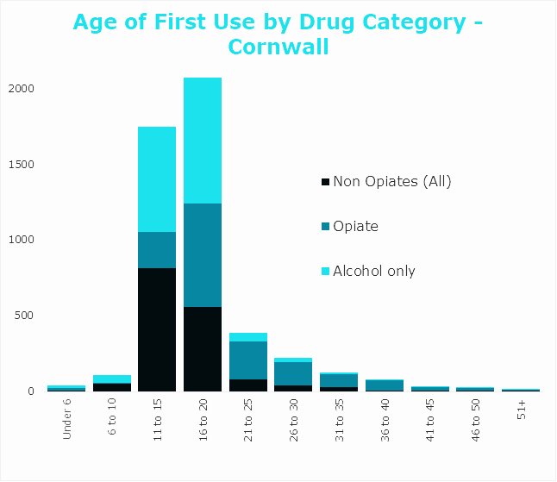
Notes:
Culture and expectancy.
Consumption patterns show a strong correlation with different socio economic position.
Heroin and tobacco use occurs increasingly within poorer social groups. Wider availability of alcohol has wider socio economic reach.
Where do they get the substance from?
Alcohol – unoffical routes due to restriction. 48 % from parents, 29% from friends,22% purchased themselves. Heaviest from friends and selves.
Drug markets operate differently. YP 5tend to purchase opportunistically and are aware of the routes.
79

Slide 80
Most young people age out of use
A much smaller percentage develop long term problems
So, what is different about these young people?
Notes:
Why screening is important.
First priority is harm reduction, safe use, and minimising risk to keep alive, alongside building upon capital and building resilience.
80

Slide 81
What is different about these young people?
1. The nature of adolescent development
2. The risk patterns that lead people into drug use.
Notes:
Alcohol is significantly different – vast proportion develop dependency much later in life after some developmental stages have been completed.

Slide 82
Life Course
0-2
Physical play, spatial awareness, co-ordination, basic nouns and verbs
2-5
Grammar, role play, moral stories, sharing, peers
5-11
Literacy, numeracy, friends, socialisation, competing
11-16
Separation from parents, peer selection, puberty, romantic partners, music, fashion
17-25
Exploring adult roles, finding one’s niche, value’s groups, partners
25+
Adult roles, careers, family
Primary Carers
Family
School
Peer Groups
Moratorium
Adult Life
Consumption and
achieving life tasks
Social Identity
Development delay
Adolescent mental
Health
Social functioning
Notes:
Examining adolescent development first, we can see that development never occurs in isolation. The nature of development is always context bound by the society in which it occurs Examining our current development across the life course, we can see how we all pass through similar social structures that influence our development in readiness for the adult world that will come.
In infancy we are largely bonded to primary carers as we learn to master our physical bodies and begin to learn the rules of our tribe through observation of what we see.
By early childhood we have shifted into become family members. Here we see the development of grammar, co-ordination and the expression of personal preferences. Moral programming through story-telling and fantasy role play begin to shape interactions, particularly with other children.
Then in childhood, we enter into school. As adults we will come to buy and sell specialist knowledge the market place of life. The more specialist our knowledge the better price we will get for this in the market place, but we need social skills to broker these deals. School provides the specialist knowledge whilst peers provide the social learning.
In adolescence we undergo rapid physical and cognitive changes. This culminates in the creation of empathy, the ability to see the world and ourselves as others do. These changes particularly peak by the age of 14. At this age, young people emotionally separate from their family and life is governed primarily by the peer group. In the declining role of family, peers will tell these young people how to behave, music will tell them what to aspire to and fashion will tell them how to dress. This is a transitory period that holds young people as they gain the ego strength to transcend into adulthood, and the period of peak peer influence.
Then at 16 we make the biggest transition since our birth. Whereas as in childhood a world of contexts was offered to us, now we must enter into adult roles and build a world for ourselves. Here we give our young a moratorium or time out period to flirt with roles and identities and find their niche. It is not until the age of 25 that we begin to settle into an adult for ourselves. Advertisers love 25 years old as they know it is when we set our purchasing pattern for life. If we are eating Weetabix at 25 we will be eating them at 83. What then follows is the movement into the institutions of adult life. Careers, families, homes, house insurance, caring for aging parents etc.
Now we can see that as we age, our lives get more complex. How do we learn to master this increasing range of complexity?
What we notice is that the life course is not random. Each stage of life is rehearsal for the next. We see that relationships with primary carers and teddy’s mastering our bodies and basic language prepares to enter into families. Grammar, morals, and fantasy role play teaches us to enter to social groups. ABC, 123, Janet and John, Harriet the Spy, the Wasteland increases our specialist knowledge by degrees. Just as “you’re not my best friend anymore, you are my best friend,” “your my girlfriend/boyfriend,” “your my partner,” “your my life partner” etc. rehearses us in our relationships. Most young people move through these development structures without noticing because they are well rehearsed.
Development is always linked to environment, they cannot be separated
Life becomes more sophisticated and demanding with time
Each life stage is a rehearsal and preparation for the next life stage
Life task achievement is the critical developmental skills we must acquire to progress to the next development stage.
Where alcohol and drug use commence point towards different related risks, e.g. developmental delay, brain development, social identity and functioning.
82

Slide 83
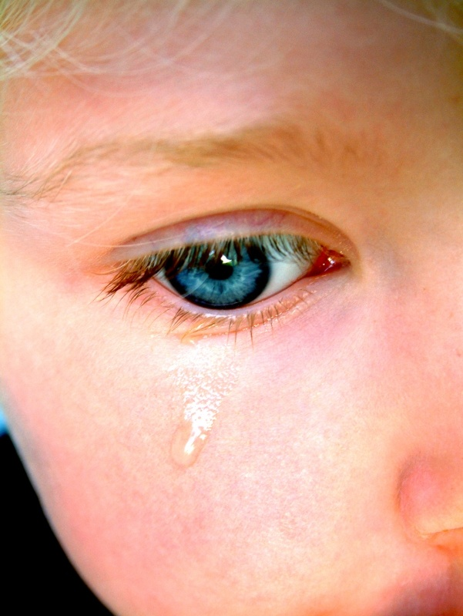
Adverse Childhood Experiences
Five Direct Direct
1. Sexual abuse by parent / caregiver
2. Emotional abuse by parent / caregiver
3. Physical abuse by parent / caregiver
4. Emotional neglect by parent / caregiver
5. Physical neglect by parent / caregiver
Five Indirect
Parent / Caregiver addicted to alcohol / other drugs
Witnessed abuse in the household
Family member in prison
Family member with a mental illness
Parent / Caregiver disappeared through abandoning family / divorce

Slide 84

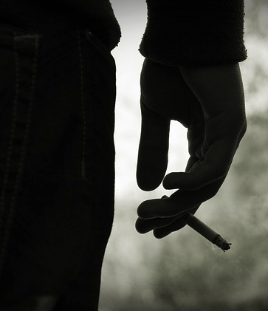





UK: Compared with no ACEs, those with 4+ ACEs were:
2x more likely to binge drink
3x more likely to be current smoker
5x more likely to have had sex under 16 years
7x more likely to be involved in recent violence
11x more likely to have used heroin or crack
11x more likely to have been incarcerated
INDEPENDENT OF POVERTY
If they had no ACEs problems could be reduced by:
Smoking
Early Sex
Heroin/Crack
Binge Drinking
Violence
16%
33%
59%
15%
60%
Aged 18-70 years
Bellis 2016
Bellis et al. 2014, n=3885

Slide 85
Sub-Trajectories
0-2
3-5
6-11
12-16
17-25
26-30
31-60
65+
Early Onset Externalised Youth
Mid Onset Internalised Youth
Late Onset Normative Youth
Early Adulthood
Fling Users
Notes:
Notes
Background vulnerability factors cluster producing predictable pathways into use
Creates externalised internalised, normative and fling pattern
The age of onset is critical as it freeze developmental process.
It is now more readily understood how long term health problems are invariably pre-cursor by mental illness and a clustered disorders. For example, it is estimated that 70 per cent of chronic illnesses cases presenting in primary care is directly related to adolescent onset mental illness.
Early Onset Externalised Youth: This population of young people have a high rate of poor impulse control disorders, scoring highly on dimensional diagnosis of Conduct Disorder / Oppositional Defiance, ADHD and Explosive Anger. They tend to hail from under-privileged backgrounds, tend to be under parented and exposed to high risk of sexual and physical abuse in childhood. They demonstrate the poorest outcomes at long term follow-up and initiate problematic behaviours such as drug and alcohol use between the ages 10-12. They are destined to become prolific offenders, experience highest rates of unemployment, divorce and family breakdown as well as receive the most complex diagnosis of personality disorder as adults.
Mid-Onset Internalised Youth: This population of young people experience a high rate of mental and emotional difficulties. This includes depression, anxiety, self-harm and anorexia. This occurs at the time of puberty where a sense of marginalisation either through sexual abuse, trauma or loss is processed differently by the developing brain. This cohort occurs across a wide range of economic backgrounds. Problematic behaviours begin between the ages of 12-14.
Late Onset Normative Youth: These young people have fairly normative, stable patterns of development. However, the emotional shift and separation from parents to peers leads them into high risk situations. Experiencing difficulty between the ages 14-16, there development achievements and stronger family supports tend to offer these young people the best chance of remission at follow up. There drug and alcohol involvement in particular can lead them into sexual exploitation, abuse and traumatic situations.
Fling Users: This is largely a student population who are the heaviest consumers of drugs and alcohol of all four groups in an intense burst of consumption. 40 per cent of college and university exclusions are for drugs and alcohol leaving a huge long term impact on their future vocational life. Research suggests that this group are largely poor and marginalised individuals who attain higher education status but feel uncomfortable and alienated from the new social environment.
The level of drug alcohol involvement has huge consequences for the developmental process itself. For example, if a young person becomes socially excluded through their use at 13, how ready will they be for adult life at when they make change at 40 having missed the critical rehearsals and practices for adult life?
Furthermore, we can see that young people’s problems are not isolated. Rather they experience a cluster of related problems that span many departments and have long term consequences. Only now are we beginning to see the connection between poor mental health and the chronic long term physical illnesses that project well onto into later life. It is now more readily understood how long term health problems are invariably pre-cursor by mental illness and a clustered disorders. For example, it is estimated that 70 per cent of chronic illnesses cases presenting in primary care is directly related to adolescent onset mental illness.
Most adults in treatment are therefore really, in the main, abused teenagers. Early onset require mush more intensive work to develop their social development.
85

Slide 86
Risk factors are accumulative
We are not born with a fixed set of risk factors.
We are born with a background set of vulnerability factors.
Just by the accident of our birth there will be risks, such as genetics, postcode, availability etc.
The more risks in the background then the more probable that we will initiate use and the earlier we start to experiment with drugs and alcohol.
Notes:
86

Slide 87
Pathways – Development & Risk
Background vulnerability factors cluster
This produces some predictable pathways into use
The age of onset is critical as it freezes developmental process.
Notes:
87

Slide 88
Risks are not even
Having alcohol problems in your parents increases your risk 2:1
Growing up in poverty 4:1
Problem user in the home 8:1
Depression 13:1
Best friend uses 14:1
4+ Adverse Childhood experiences = 11-16 times more likely to become dependent upon heroin
Notes:
88

Slide 89
Cornwall
There are an estimated 2800 dependent drug users in Cornwall
Just over half of these are engaged in treatment
Twice as many experiencing some degree of problematic use

Slide 90
Addiction and dependence
Drug use is relatively common
The most common pattern of use of psychoactive substances is episodic and non-problematic
Notes:
It is widely believed that drug addiction is the result of someone simply taking a drug casually for pleasure, then becoming accidentally “hooked” on the chemical substances within the drug and thereafter “enslaved.” However, this is based on a misunderstanding of addiction.

Slide 91
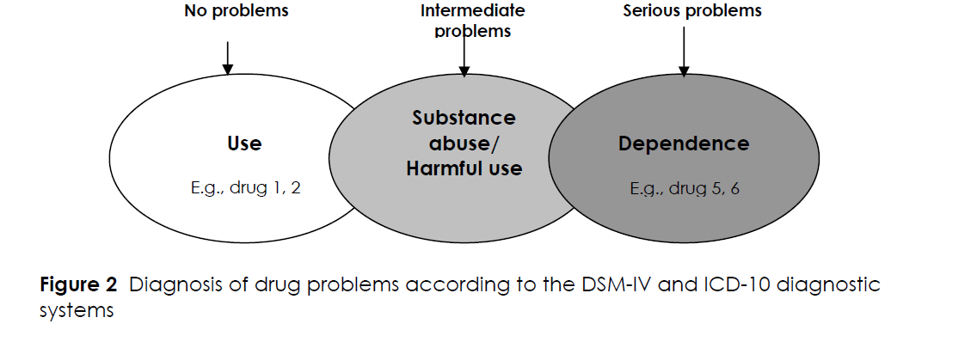

Slide 92
What is ‘Tolerance’?
Needing to increase dose to continue to have the same effect
To avoid withdrawal
Develops differently with different drugs

Slide 93
Language is important
Affects Beliefs and expectations
Labelling
‘I’m an addict’ ‘I’m in active addiction’
Who else are they?
‘I’m clean’ ‘She’s clean’ ‘He’s clean’
Implies that they were dirty.

Slide 94
Dependence, ‘Motivation’ & Change
The Cycle of Change
Prochaska and DeClemente

Slide 95
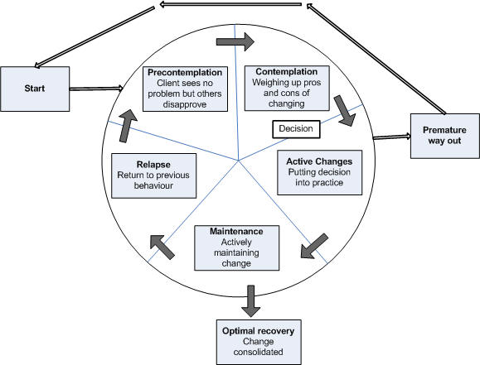

Slide 96
What contributes to the best outcomes?

Slide 97
What contributes to the best outcomes?
Clue: It’s not ‘motivation’

Slide 98
What contributes to the best outcomes?
Clue: It’s not ‘motivation’
The characteristics of services and helpers are more important indicators and contributors to outcomes than any expressed motivation by the service user.

Slide 99
What contributes to the best outcomes?
Clue: It’s not ‘motivation’
The characteristics of services are more important indicators and contributors to outcomes than any expressed motivation by the service user.
1. The ‘Therapeutic Alliance’
Rapport, and a trusted relationship
2. Acting on real-time feedback

Slide 100
What help is available?
Open access specialist services, e.g. drop in, needle exchange, advice and information
For anyone - Approx. 2500 people access p.a.
Structured specialist treatment, e.g. NICE guidance structured psychosocial and prescribing
For People who are dependent - 2600 places (alcohol & drugs)
Residential assessment, stabilisation and detox
10% of treatment population 260 people p.a.
Residential Rehabilitation
5% of the treatment population – 130 people p.a.
Notes:
Add table to show numbers and costs.
History of providers.

Slide 101






Home
Spouse
Friends
Exercise
Job
Alcohol
Health
Drugs
Hobbies
Education

Slide 102



Recovery - ‘An individual person-centred journey’
Recovery Capital:
HUMAN
Skills, mental and physical
health & a job
CULTURAL
Beliefs/ desires around
recovery
SOCIAL
Support networks
PHYSICAL
Resources – finance & housing
Notes:
102

Slide 103

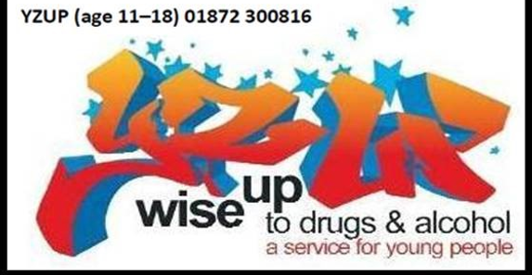
Useful resources
We Are With You 0333 2000 325
YZUP 01872 300816
www.wearewithyou.org.uk
www.cornwall.gov.uk/drugsandalcohol
www.safercornwall.co.uk
www.talktofrank.com
https://www.drugwise.org.uk/drugsearch-encyclopedia/
KFX.org.uk
www.drugsandhousing.co.uk
www.erowid.org

