Slide 1

Hate Crime in Cornwall
Facts & Figures
2025/26

Slide 2
What is hate crime?
Hate crime is defined as any criminal offence which is perceived, by the victim or any other person, to be motivated by hostility or prejudice towards someone based on a personal characteristic
The law recognises five categories of ‘personal characteristic’ for this purpose. Devon & Cornwall police also record incidents motivated by hostility or prejudice towards sex (misogyny/misandry).
Race or Ethnicity
Religion or Belief
Sexual Orientation
Transgender Identity
Disability

Slide 3
National picture
c
Crime Survey
0.3% of adults were victims of any hate crime in the last year
No recent change in prevalence but a fall over the longer-term
44% of all hate crime reported to police
3x greater impact emotionally than all crime
Drop in satisfaction with police response
Police recorded crime
3% of all recorded crime in 2025/26
Increased by 7%; race and religious hate crimes increased, other types fell
Reported hate crime has trebled in 10 years - improved identification and recording
10% of hate crimes resulted in a charge/summons
Source: Office for National Statistics
Notes:
Source (police recorded crime): Hate crime, England and Wales, year ending March 2026 - GOV.UK
The Crime Survey for England and Wales (CSEW) is a face-to-face victimisation survey run by the Office for National Statistics and provides estimates on hate crimes experienced by people resident in households in England and Wales. The size of the CSEW sample means the number of hate crime incidents and victims estimated in a single survey year is too unreliable to report on. Therefore, 3 annual datasets are combined to provide a larger sample which can be used to produce robust estimates for hate crime. Estimates for the combined surveys from the year ending March 2023 to the year ending March 2025 were published in the year ending March 2025 hate crime statistical bulletin, with the next estimates due to be published in 2028.

Slide 4
What we have seen in Cornwall
An escalation in hostile language and behaviours, particularly online and our minority communities report feeling more at risk
Fear of violence drives deliberate changes in behaviour to be less visible within communities to avoid being harmed
Persistent verbal incidents and micro-aggressions have a cumulative impact on resilience and emotional wellbeing
Encouraging respectful conversations and providing support for young people plays an important role in community cohesion
There may be hidden harms in rural areas, particularly for international workers if they are isolated in communities
Misinformation in the online space impacts on real events and increases risk of harms; concerning use of safeguarding language to promote discrimination and division
Notes:
Source: Safer Cornwall Strategic Assessment – MoRiLE workshop papers

Slide 5
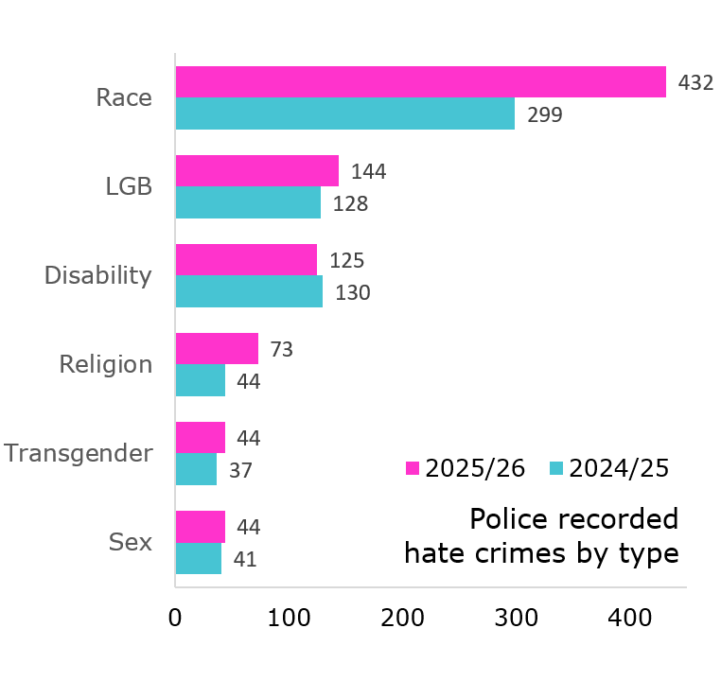
Key statistics for Cornwall – 2025/26
763 crimes p+25%, 2.1% of all recorded crime
Most reported hate crimes are motivated by race (57%); racist crimes up 44% from last year
Some increase seen in all categories, except disability-related hate crime
Police data is only part of the picture - reported crime is affected by police reporting practice and community confidence to report
Source: Devon and Cornwall Police recorded crime data
Notes:
Source: Devon and Cornwall Police recorded crime data

Slide 6
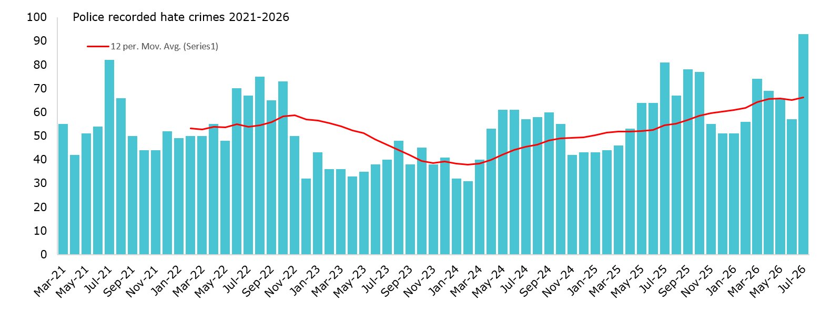
Trends in reporting
Key trend: Steady increase in reported crimes over the last 2 years as recording has improved; 25% rise in 2025/26 compared with the previous year
Source: Devon and Cornwall Police recorded crime data
Notes:
Sources: Devon and Cornwall Police recorded crime data

Slide 7
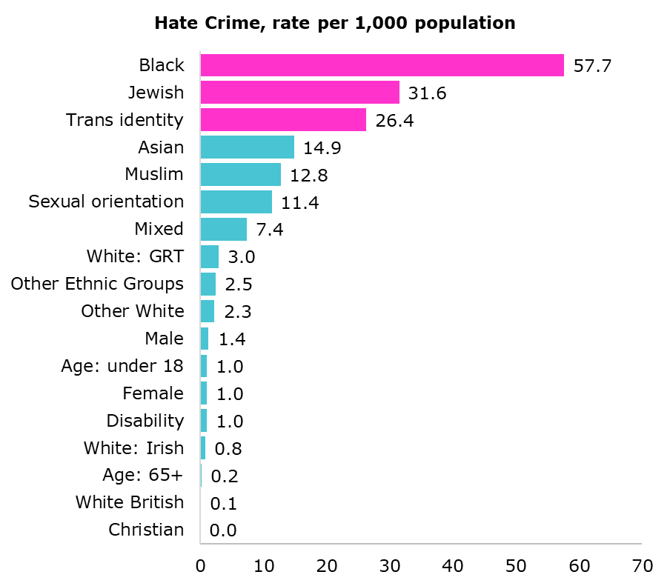
Experience of hate crime by group
Some minority groups experience higher levels of victimisation than others
The highest rates of reported hate crime are for black people, people who identify as transgender and for the Jewish community
Some people face overlapping forms of discrimination due to multiple characteristics, such as race, religion, and sexual orientation, leading to complex and compounding impacts on the person/s affected.
Source: Devon and Cornwall Police recorded crime data and Census 2021 population

Slide 8
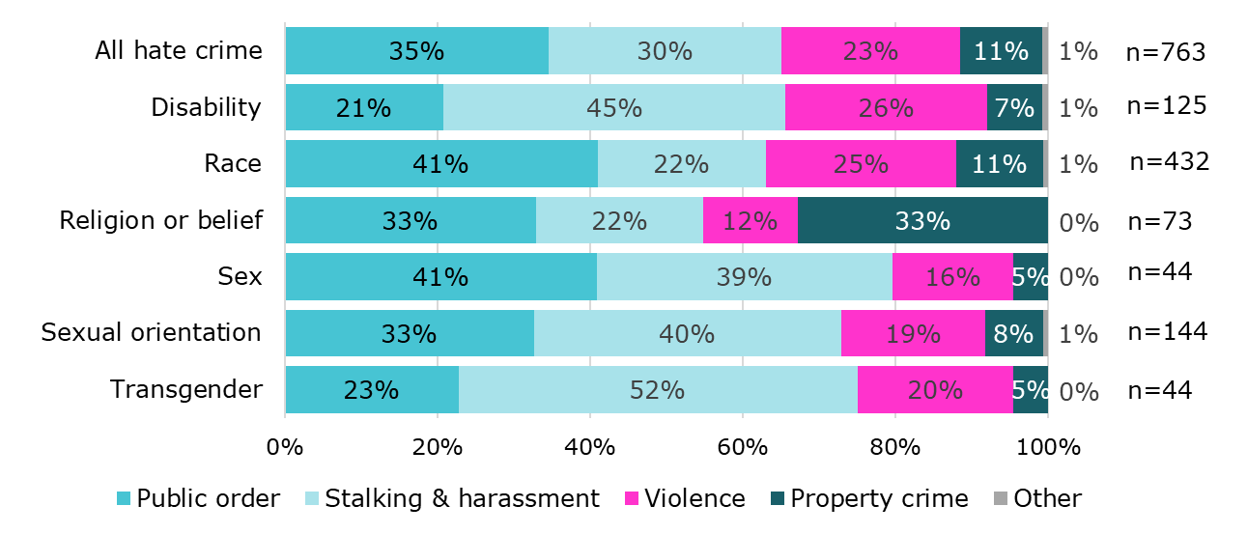
Impact and harm
Public order offences and stalking and harassment are the most common types of hate crime, and account for most of the rise in reported crime
23% of hate crimes relate to violence, of which one in four result in physical harm. Serious assaults do occur, but are extremely rare
Police data indicates a higher level of property loss/damage within crimes motivated by religion; this is primarily criminal damage.
Source: Devon and Cornwall Police recorded crime data
Notes:
Source: Devon and Cornwall Police recorded crime data;

Slide 9
Have Your Say Survey 2026: who responded
790 responses in 2026
Higher representation of women and age groups 45+ years; fewer young people
5% identified as Lesbian, Gay or Bisexual
Less than 5 people identified as Trans
2% were from Black, Asian or other minority ethnic groups
7% religions other than Christian or none
34% disclosed a disability/long term health condition
Notes:
Source: Have Your Say Survey 2025

Slide 10
Have Your Say 2026: experience of hate incidents
1 in 5 people told us they had seen or experienced discrimination, harassment or abuse in their local area
Respondents were most likely to have witnessed or experienced incidents related to race (42%), and sexual orientation (23%)
26% of people reported it; the most common reason for not reporting was low confidence that action would be taken (49%)
11% of respondents experienced bullying or harassment online, of which 28% was hate-related
Notes:
Source: Have Your Say Survey 2025

Slide 11
Have Your Say 2026: community cohesion
6 out of 10 people told us
that in their local area people from different backgrounds get on well together
Community spirit is the strongest positive factor (41% of positive respondents)
Concerns about crime, drugs and anti-social behaviour is the strongest negative factor (27% of negative respondents)
Notes:
Source: Have Your Say Survey 2025

Slide 12
What people said…
This is a welcoming community
We live in a multi cultural area
and all get on well
Our local community is open
and friendly
Neighbours say hello and look after each other
I have never seen animosity between people of differing backgrounds
We have a tremendous collaborative community
Local events, encouraging the community to come together for free
Good work by community groups
We have a mixture of ages, races and nationalities in our road; people are friendly and look out for each other
A lot people moving here with little respect for our town or community
Hate crime towards LGBT community, primarily on social media
Constant anti social behaviour, drugs, parties and noise
The majority keep themselves to themselves
Harassment and antisocial behaviour going on that isn’t being resolved
People only like who they know and do not accept new people
Some people don’t want to mix
Anti social behaviour has divided
the community
Hostility about change,
immigration, tourists
Source: Have Your Say Survey 2026
Notes:
Source: Have Your Say Survey 2026

Slide 13
To find out more
https://safercornwall.co.uk/hate-crime/
Email us at communitysafety@cornwall.gov.uk
Notes:
13

